Slide 1
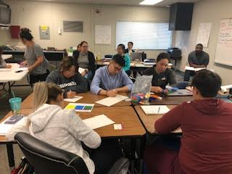
UDL Preparation Class Activity
Math Lesson using GO MATH (District adopted)

Slide 2
Go Math Sample Lesson 2nd Grade
With the lesson provided use the Lesson Plan Template and move the lesson into that format.

Slide 3
Identify Barriers
In pairs look at your plans.
Did you put most of the same info into each section. Make adjustments based on your discussion.
At each step determine if what is required would be a barrier to any student. If yes, what is the barrier. (IT IS NEVER A STUDENT)

Slide 4
Go Math Sample Lesson 2nd Grade: Roles
Roles:
Group 1: Students in the classroom participating in the lesson
Group 2: Observers writing down what was seen in the lesson

Slide 5
Classroom Expectations
Students will be respectful to all members of the learning community
Students will explain their thinking and the thinking of others
Students will ask questions when they do not understand
We will all work together as equal members of the learning community
Routines:
CHAMPS expectations are put in place for activities
Teacher/Student Game to reinforce CHAMPS
Playing Cards

Slide 6
Welcome Back from Recess Today’s Activities
Group/Partner Talk
C- Voice Level 1
H – Ask your partners
Raise your Hand
A- Solving Math
Problems Together
M- Getting supplies
P – Speaking and listening
Mathematicians
Class Discussion
C- Voice Level 0 listening
Voice Level 2 Speaking
H – Raise your Hand
Silent Signals
A- Learning about Math
M- None
P – Speaking and listening
Mathematicians
Independent Work
C- Voice Level 0
H –Raise your Hand
A- Solving Math
Problems
M- Teacher Permission
P – Completing math work
S- Mathematicians are learning and growing together

Slide 7
Warm Up 1:
How many ways can you make the number…..
25

Slide 8
Warm Up 2:
How many ways can you make the number
36

Slide 9
How can we use the same strategy to describe each of the numbers
25
36
42
27
48
Your own number

Slide 10
Our Question of the day:
How can I break apart addends to add numbers?

Slide 11
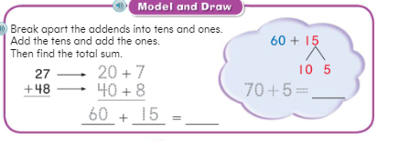
Try This problem
Jennifer has 27 Pokemon cards on her desk and Carlo has 48 Pokemon cards. If you put all of the cards into a pile, how many cards would you have altogether?

Slide 12
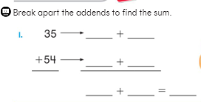
Work with a Partner to solve the problems

Slide 13
How did you solve the problems?
Using addends, how did you solve the problem of:
35 + 54
Using addends, how did you solve the problem of:
43 + 29

Slide 14
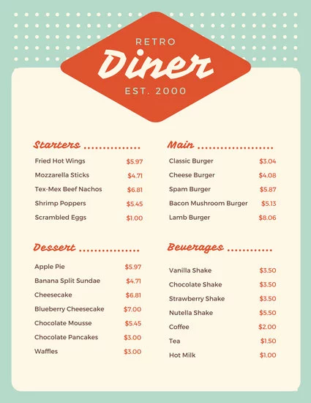
Practice Time: Practice your work (15 minutes)
Appetizer (Everyone Must Do):
Math Workbook 4, 5, 6, 7
Entrée (Choose 1 to Complete):
Work with a Partner: Math Workbook 8, 9, 10
Computer Time: Personal Math Trainer
Group Work: Work on Math with Mrs. Dozier
Dessert (Complete if you have time):
Poster: Create a word problem poster using 2 digit addition, make an answer key on the back
Enrich Worksheet
Game with a Partner: 2 Digit Shuffle

Slide 15
Exit Ticket
Thao read 19 pages in her chapter book on Monday. She read 12 pages on Tuesday. How many pages did Julie read this week?
Show your work.

Slide 16
Debrief: What UDL solutions were used?
Add to your forms in right column of SOLUTIONS
Manipulatives
Use of playing cards
White Boards
Talked to Jacob prior to lesson to upfront answer
Group time and choice of way to solve
Diner menu of choice at the end +++

